Slide 1
NLP From Scratch
Solving the cold start problem for natural language processing
San Francisco, CA
Norris Heintzelman
Michael Johnson
© 2018 Lockheed Martin Corporation. All Rights Reserved.
Notes:
Norris.h.Heintzelman@lmco.com
michael.c.johnson@lmco.com

Slide 2
(obligatory picture of F-35)

Slide 3
How can we extract supply chain risk from open source unstructured data?
Exclusive: UTC set to win EU approval for $23 billion Rockwell Collins deal
The deal, announced in September last year, would create a new player in the top echelon of suppliers to Boeing, Airbus, Bombardier, and other plane makers
Contract negotiations
Part number integrity
Business Stability

Slide 4
How Do You Define Risk?
Predictive Models
Relevance To LM
Supply Chain
Knowledge
Categorization
Risk

Slide 5
Typical NLP approaches require lots of human labeled training data

Slide 6
Hybrid Systems
Human
Machine
‘Truth’, Intuition
Speed, Consistency

Slide 7
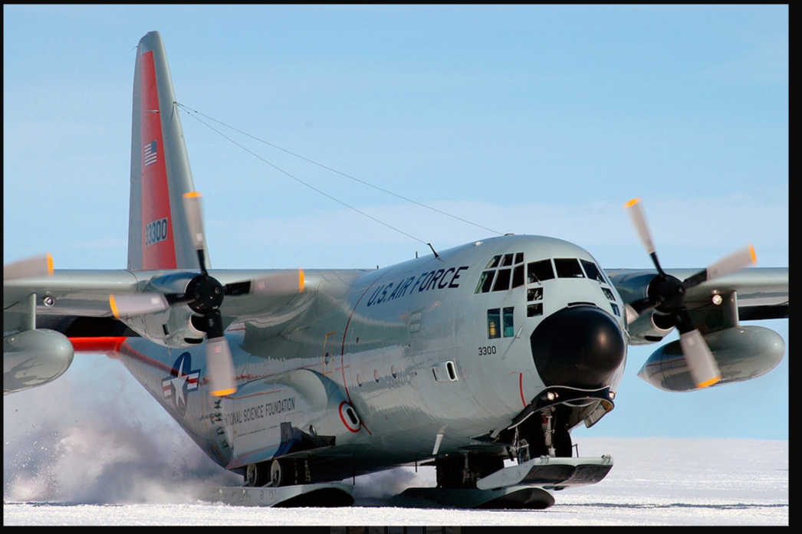
Cold Start Problem
How do you train a machine learning model with no training data?
Hybrid Rules/Machine Learning
Transfer Learning + Active Learning
Use Pre Trained Models
Creative Training Sets

Slide 8
Weak Supervision
Rule/Heuristic
Machine Learning
VS
High precision
Easily written/evaluated by humans
Rigid/Fragile
Can Generalize
Probabilistic
Requires hand labeled data

Slide 9
Weak Supervision
Rule/Heuristic
Machine Learning
Feed rules-based labels to ML Model
ML Model will just memorize rules

Slide 10
Weak Supervision
Rule/Heuristic
Apply Rules to Titles
Machine Learning
UTC set to win EU approval for $23 billion Rockwell Collins deal
The deal, announced in September last year, would create a new player in the top echelon of suppliers to Boeing, Airbus, Bombardier, and other plane makers…
Feed text to ML Model
ML Model will learn flexible rules
How do you write a rule?

Slide 11
Example Rule: Merger and Acquisition Using spaCy
Tokenize/Match
NER
NER
<Company> merge | acquire <Company>
Dependency Parse
Notes:
Ask “how do you do the machine learning?”

Slide 12
Example Model: WV Pre-Training + CNN
Large Unlabeled corpus (e.g. wikitext103)
Train word embeddings
Insert embeddings as first layer
Train remaining layers
Labeled Training Set
MandA
Financial Distress

Slide 13
Weakly Supervised Learning: Performance
UltraTech sweetens offer for Binani Cement UltraTech
97% Precision
85% Precision
330,000 Articles
500 Identified with Simple MandA Rule
Train CNN Classifier
6,000 articles marked as MandA
Paramount acquires CKE ATM Solutions
UltraTech sweetens offer for Binani Cement UltraTech
Dec. 18, 2018 Lancaster, Pennsylvania-based Paramount Management Group has acquired CKE ATM Solutions, a Morristown, New Jersey-based-provider of ATM outsourcing services to credit unions and mid-tier financial institutions, according to a press release.
In a move to beat a rival consortium backed by Bain Capital, Kumar Mangalam Birla-owned UltraTech Cement has increased its bid for Binani Cement...
Training considerations:
Carefully control sampling of majority (negative) class
Pre-train your word vectors
If you have a large enough corpus (~50m tokens) use that
If not, use pretrained (fasttext, glove, word2vec)
Works well when:
You have lots of unlabeled data
Your class target class is a minority
You can write a high precision rule
Can we apply a similar strategy to NER?

Slide 14
Custom Named Entity Recognition (NER) Model
Training usually lots of humans marking text
Based in Santa Maria, 7 Days Plumbing Repairs Plus is a plumbing contractor that provides water purification system installation, leak detection and other services.
Based in Santa Maria, 7 Days Plumbing Repairs Plus is a plumbing contractor that provides water purification system installation, leak detection and other services.
Date
Location
Organization
Product/Service
Notes:
Can we leverage the strengths of many automated sources for better performance on our data?

Slide 15
Custom NER Model using SpaCy
Based in Santa Maria, 7 Days Plumbing Repairs Plus is a plumbing contractor that provides water purification system installation, leak detection and other services.
SpaCy Date
SpaCy Location

Slide 16
Custom NER Model using SpaCy
Based in Santa Maria, 7 Days Plumbing Repairs Plus is a plumbing contractor that provides water purification system installation, leak detection and other services.
SpaCy Date
SpaCy Location
Company Name Rules

Slide 17
Custom NER Model using SpaCy
Based in Santa Maria, 7 Days Plumbing Repairs Plus is a plumbing contractor that provides water purification system installation, leak detection and other services.
SpaCy Date
SpaCy Location
Company Name Rules
Other Engine Organization

Slide 18
Custom NER Model using SpaCy
Based in Santa Maria, 7 Days Plumbing Repairs Plus is a plumbing contractor that provides water purification system installation, leak detection and other services.
SpaCy Date
SpaCy Location
Company Name Rules
Other Engine Organization
Products/Service Rules

Slide 19
Custom NER Model using SpaCy
Based in Santa Maria, 7 Days Plumbing Repairs Plus is a plumbing contractor that provides water purification system installation, leak detection and other services.
SpaCy Date
SpaCy Location
Company Name Rules
Other Engine Organization
Products/Service Rules
But we need non-overlapping labels (AKA Annotations)
So we assign confidence values, and in an overlap, pick the highest confidence
Company Name Rules High Confidence
Products/Service Rules High Confidence
SpaCy Date Medium Confidence
SpaCy Location Medium Confidence
Other Engine Organization Low Confidence
Note: the assignment of confidences to particular situations could be quite sophisticated

Slide 20
Custom NER Model using SpaCy
Based in Santa Maria, 7 Days Plumbing Repairs Plus is a plumbing contractor that provides water purification system installation, leak detection and other services.
Date
Location
Organization
Product/Service
Now we just need several thousand more such sentences and some labor to review, correct, add variability
Notes:
Still need human ground truth

Slide 21
Real Results:
“Rockwell Collins (COL) surpassed the Zacks Consensus Estimate in three of the trailing four quarters, with an average beat of 2.61%.”
Spacy English Large Out of Box Model
Rockwell Collins PERSON COL ORG
the Zacks Consensus Estimate ORG
three CARDINAL four quarters DATE 2.61% PERCENT
New Spacy Model trained on Spacy Eng Large Tags plus Name Rules
Rockwell Collins ORG COL ORG the Zacks Consensus Estimate ORG three CARDINAL four quarters DATE 2.61% PERCENT
What if training data already exists, but not where you expect it?

Slide 22
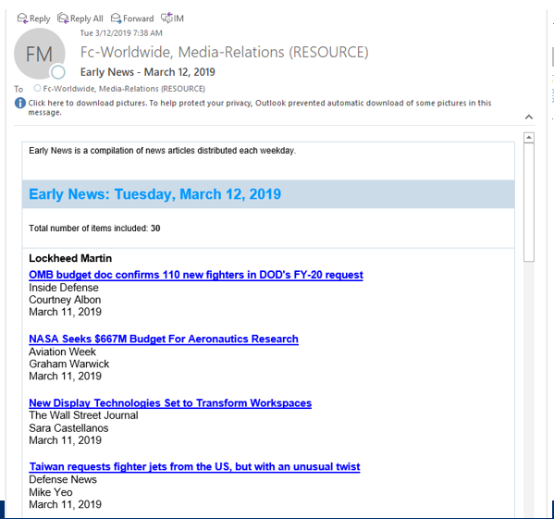
Creative Training Sets
83k hand picked news stories from 2000-2018
Challenges:
Only positive examples!
Generalize model
How do you train w/only positive examples
Joint WV training
Balance sampling
Data cleaning
Target Corpus
False
True Set
True

Slide 23
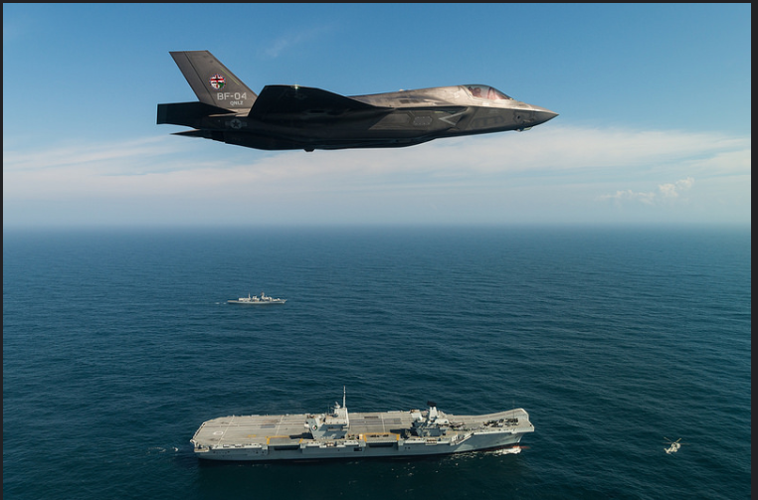
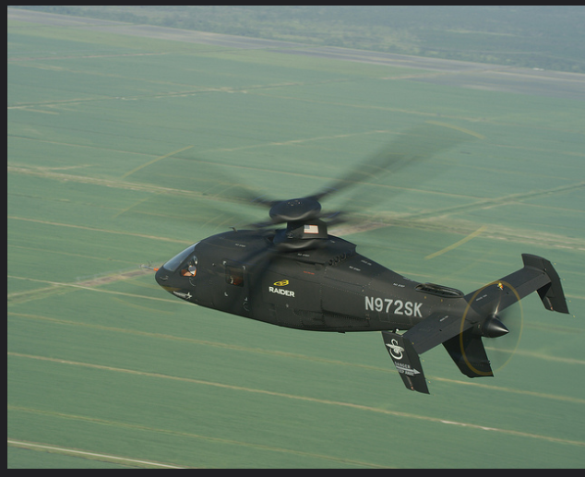
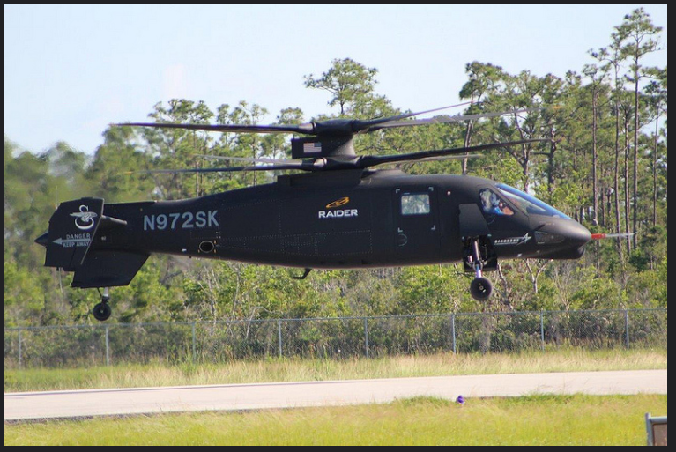
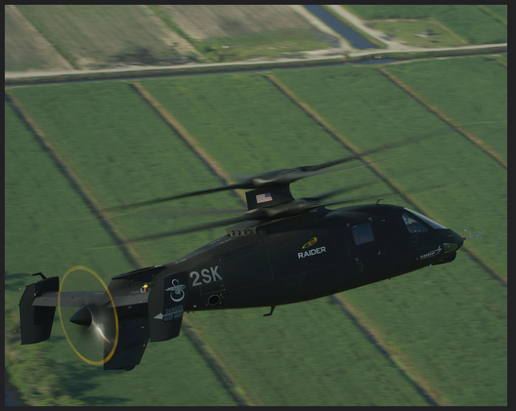
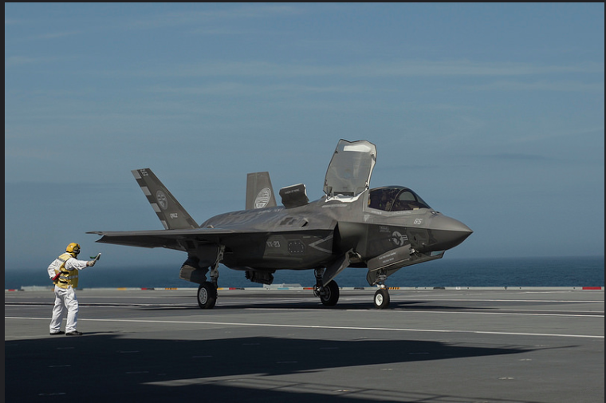
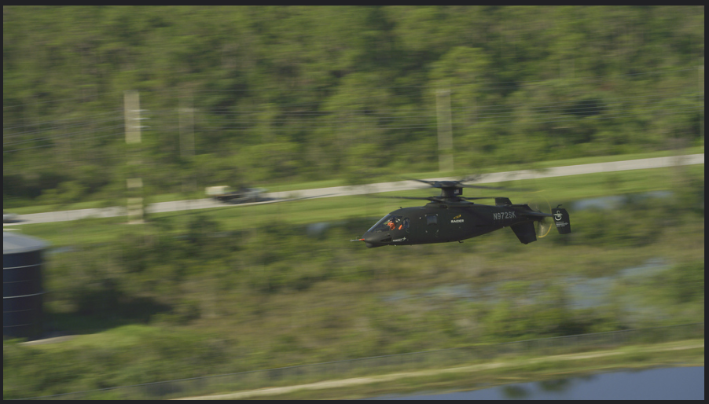
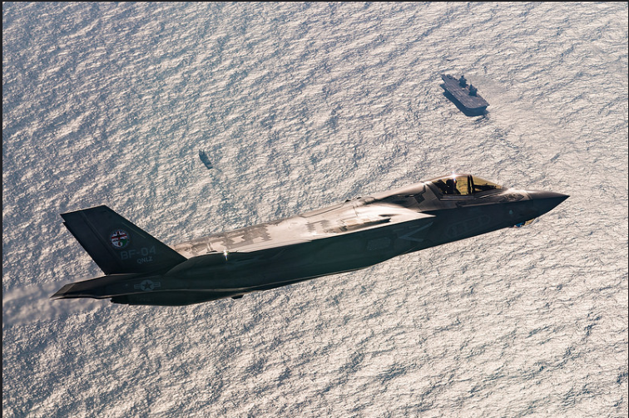
Models Learn Obvious Features
Sikorsky S-97 Raider vs F-35

Slide 24
How do you collect ground truth?

Slide 25
Active Learning: Relevance + Classification
Intelligent Document Selection
Corpus
Pre- Processing
Select best documents for labeling
No: Keep Training
Human Tagging
Yes: Use Machine Tags
Accuracy > Threshold?
Explosion_AI: Prodigy
Bankruptcy
MandA
Labor Relations
Write Machine Tags to Database
Machine Tagging + Validation
Bankruptcy

Slide 26
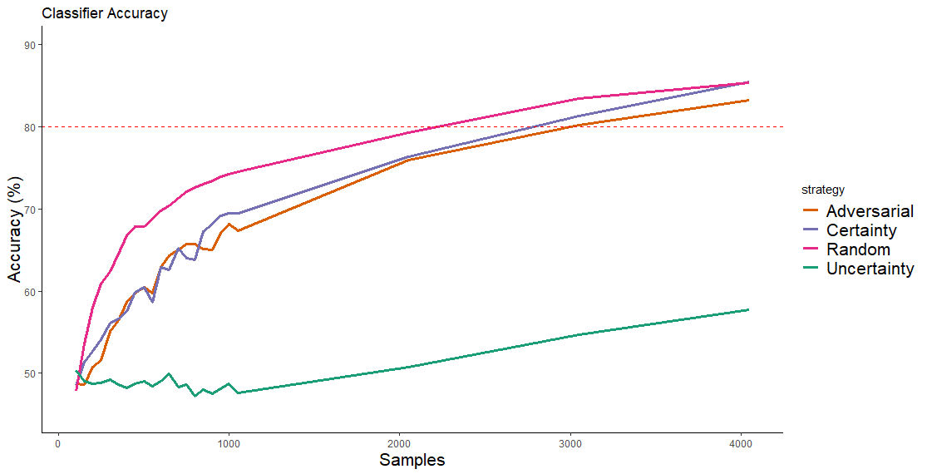
Adversarial Sampling
Random Selection outperforms others @ low sample size

Slide 27
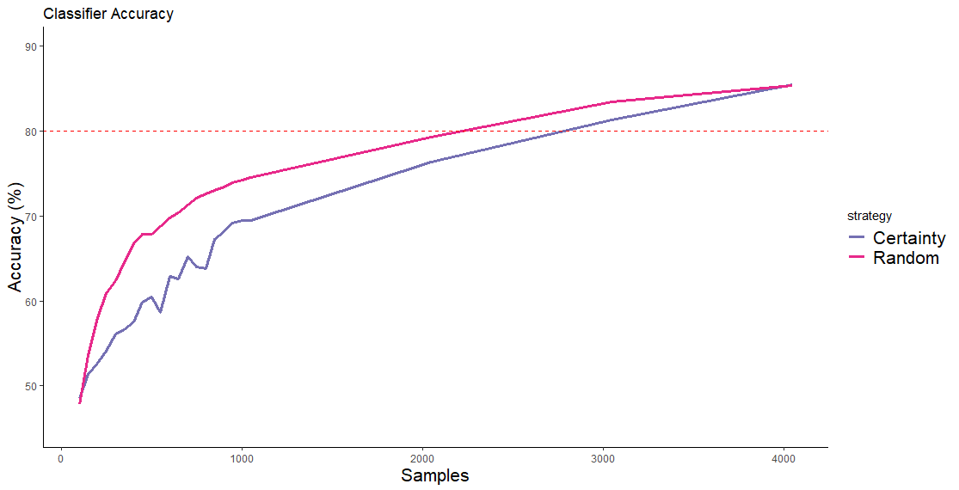
‘Elbow’ Sampling
Random Sampling Domain
Certainty Sampling Domain

Slide 28
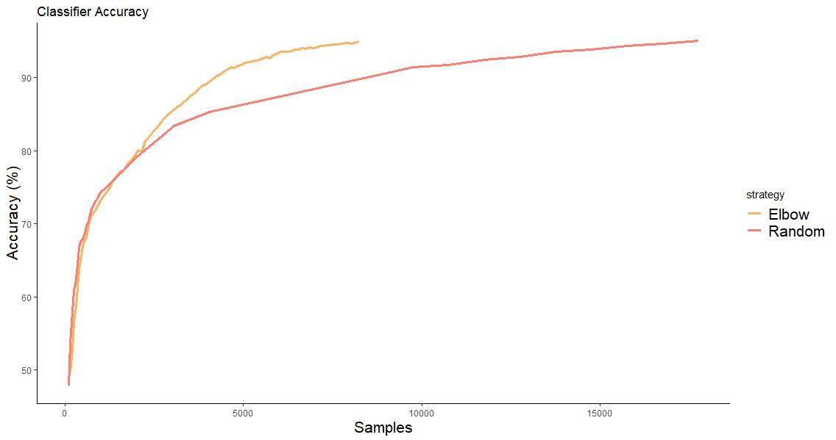
Elbow Sampling Results
Elbow sampling requires 2X fewer samples to achieve full accuracy
Start certainty sampling

Slide 29
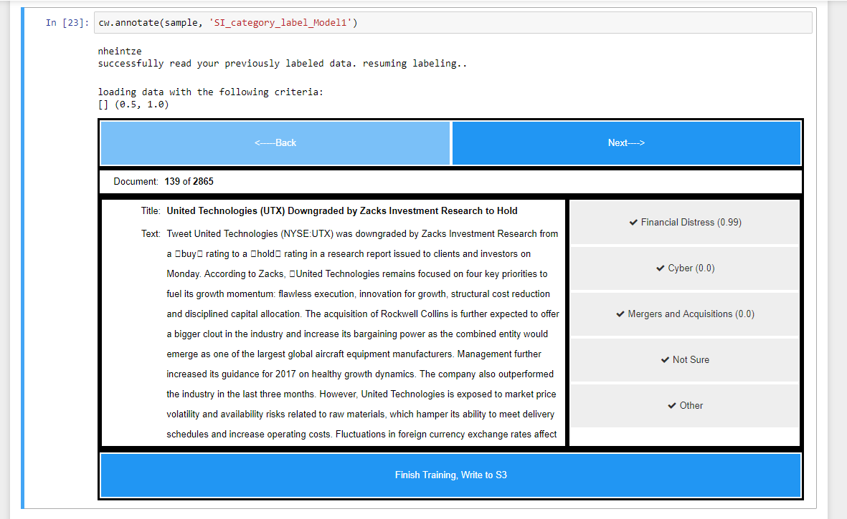
Capture Human Ground Truth as Part of Process
Reads pandas data frame
Loads configuration/previous labels
Pick sampling domain
Logs each user’s labels
Write back to S3

Slide 30
Active Learning: Relevance + Classification
Intelligent Document Selection
Corpus
Pre- Processing
Select best documents for labeling
No: Keep Training
Human Tagging
Yes: Use Machine Tags
Accuracy > Threshold?
Bankruptcy
MandA
Labor Relations
Write Machine Tags to Database
Machine Tagging + Validation
Bankruptcy

Slide 31
Transfer Learning for NLP 1.0: Pre Trained Word Vectors
Train word embeddings
WikiText103:
100m Tokens
Insert embeddings as first layer
Train remaining layers
Labeled Training Set
Positive Review
Negative Review

Slide 32
CNN + Word2Vec Issues
Approach only bootstraps first layer of the network.
Loses complex structure captured in language
Word vectors are context independent. Words with multiple meanings are captured generically:
Take it to the bank.
He slammed into the bank.
He took a bank shot.
Can we do better?

Slide 33
Transfer Learning 2.0: Language Model Pre Training
Train Language Model
WikiText103:
100m Tokens
… with only 100 labeled examples, it matches the performance of training from scratch on 100x more data…
Fine tune LM on target data set
Unlabeled training set
Fine Tune Remaining layers
Universal Language Model Fine-tuning for Text Classification
Jeremy Howard, Sebastian Ruder
Labeled Training Set
Positive Review
Negative Review

Slide 34
Our Experience W/ Language Modeling
CNN Architecture is robust across many domains
Good place to start
Fast
Consider language model pre training if:
Your domain is sufficiently similar to pre trained model (news, blogs, social media posts, etc) OR
You have sufficient in-domain documents to pre train language model
Changes are afoot: transfer learning for NLP is here
ULMFit: Language Model Fine Tuning
ELMo: Contextualized word representations
BERT: Bidirectional embeddings with attention
Approach | GPU | Training Time
Doc2Vec + SVM | None | 10Min
CNN + Pre Trained W2Vec | Tesla V100 | 10 Min
AWD-LSTM | Tesla V100 | 10-15 Hours

Slide 35
Conclusions
There is no substitute for (at least some) ground truth!
Break down ML problems into accomplishable steps
Custom models are difficult to tune maintain
Cleaning is more likely to improve performance than tuning
Non deterministic
Buy vs Build:
Snorkel
Weak supervision
Prodigy
Does your training set already exist?

